Slide 1

PYCON 2019
Exploratory Data Analysis and Feature Engineering: Python a great tool to use.

Slide 2

ADESIJI BLESSING
TUTOR
DATA ANALYST AT SMARTERISE
PETROLEUM ENGINEERING GRADUATE, UNIVERSITY OF IBADAN
Email: blessingadesiji96@gmail.com
Twitter: AdesijiBlessing
Linkedln: Adesiji Blessing
Instagram: bleso_a
Kaggle: kaggle.com/abtoye
Zindi: https://zindi.africa/users/AdesijiBlessing_DSN

Slide 3

WHAT IS EDA ?
It is a preliminary step in data analytics to:
Summarize the main characteristics of the data
Gain better understanding of the data set.
Uncover relationships between variables.
You are trying answer a question by doing EDA.

Slide 4

Objectives of EDA
Quickly describe a dataset; number of rows/columns, missing data, data types, preview.
Clean corrupted data; handle missing data, invalid data types, incorrect values.
Visualize data distributions; bar charts, histograms, box plots.
Calculate and visualize correlations (relationships) between variables; heat map.

Slide 5
Descriptive Statistics
Before building complicated models, create time to actually explore your data. The first important step is to calculate some descriptive statistics for the data.
Descriptive statistical analysis helps to describe basic features of a dataset and obtains a short summary of the sample and measures of the data.
Method- df.describe()
To do this we can use the describe function on the DataFrame. The function automatically computes the basic statistics for all numeric variables. It gives the mean, the total data points, standard deviation, the quartiles and the max and min (extreme values). It gives a holistic view of the dataset.
N.B: NaN values are not computed in this summary.

Slide 6
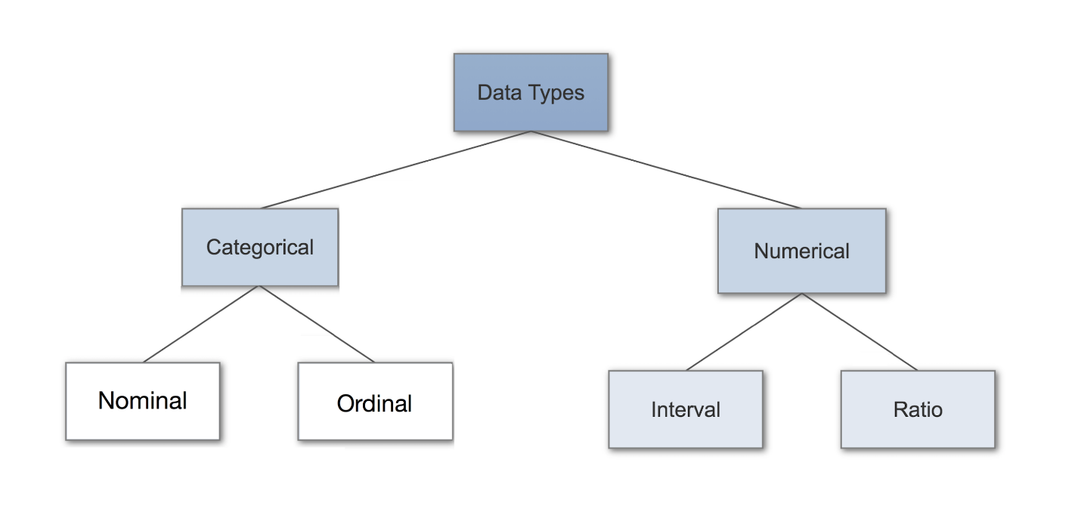
Types of Data

Slide 7
DataFrame Attributes for EDA
Df.head() – shows the first five rows
Df.shape – shows row by column
Df.columns – List of variable names.
Selecting a column – Use the square bracket operator with the string as the key. The result is a series
NaN – Not a number is a special value that shows invalid or missing number
Validating your Data
Df.value_counts().sort_index() – We can use values count to get the sense of our data by knowing how many times each values appears
DF.describe() – It compute summary statistics of the data

Slide 8


